Slide 1
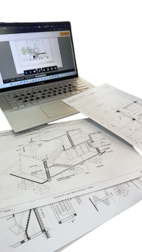

THE DESIGN JOURNEY 2025
FOUNDATION STUDIO
.
.
.
.
.
PRESENTED BY: AMNA MURTAZA
2025-ARCH-4

Slide 2
THE DESIGN JOURNEY 2025
FOUNDATION STUDIO
.
.
.
.
.
PRESENTED BY: AMNA MURTAZA
2025-ARCH-4

Slide 3
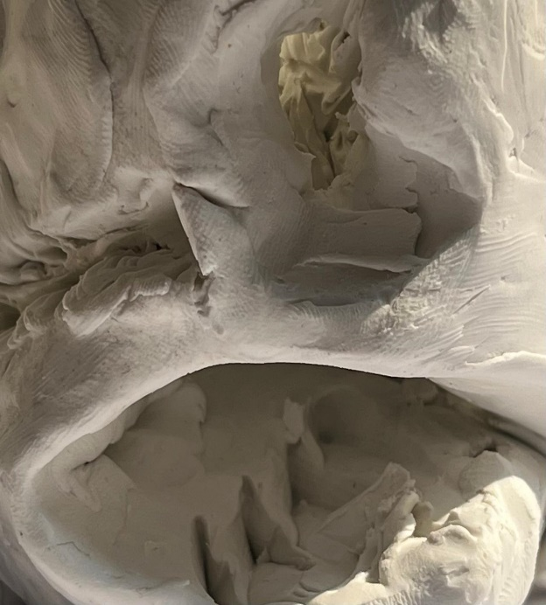
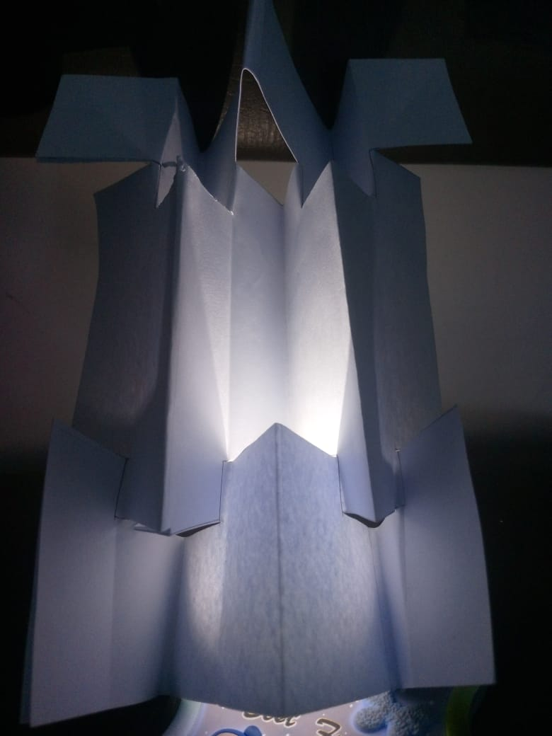
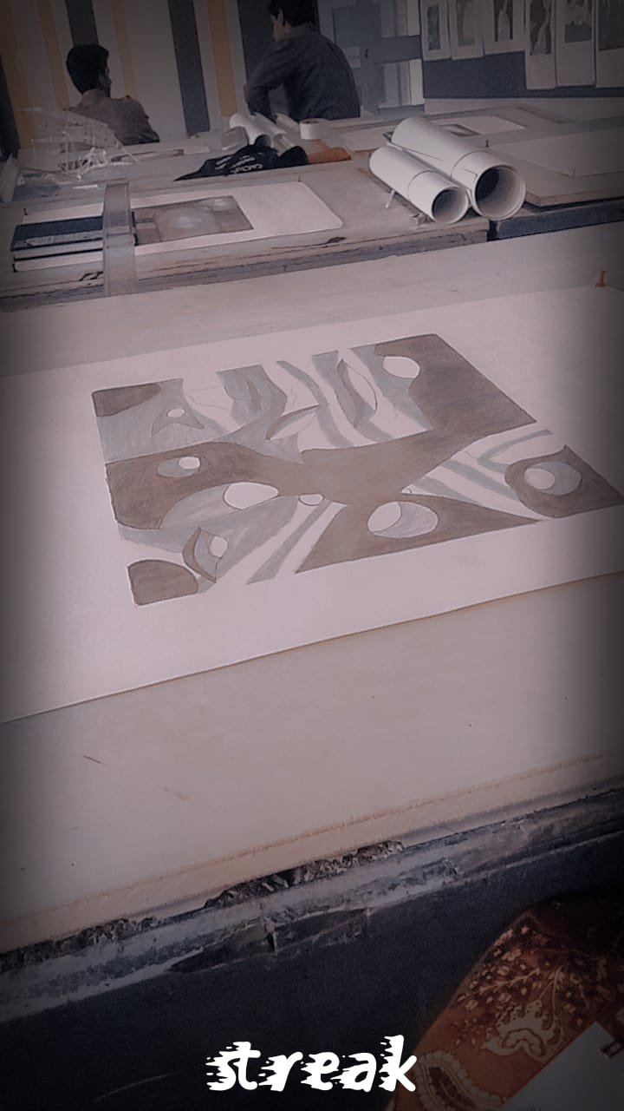
OUR STUDIO WORK PEICES
DESCRIPTION
Designing timeless spaces that inspire creativity and elevate everyday living
We believe every structure tells a story- a story of people purpose and place.
Our design blend modern innovation with sustainable solutions.
Building your future together
Our portfolio showcase
Innovative designs-from minimalist homes to dynamic commercial spaces.
We are committed to shaping the future of architecture with creativity and passion.

Slide 4

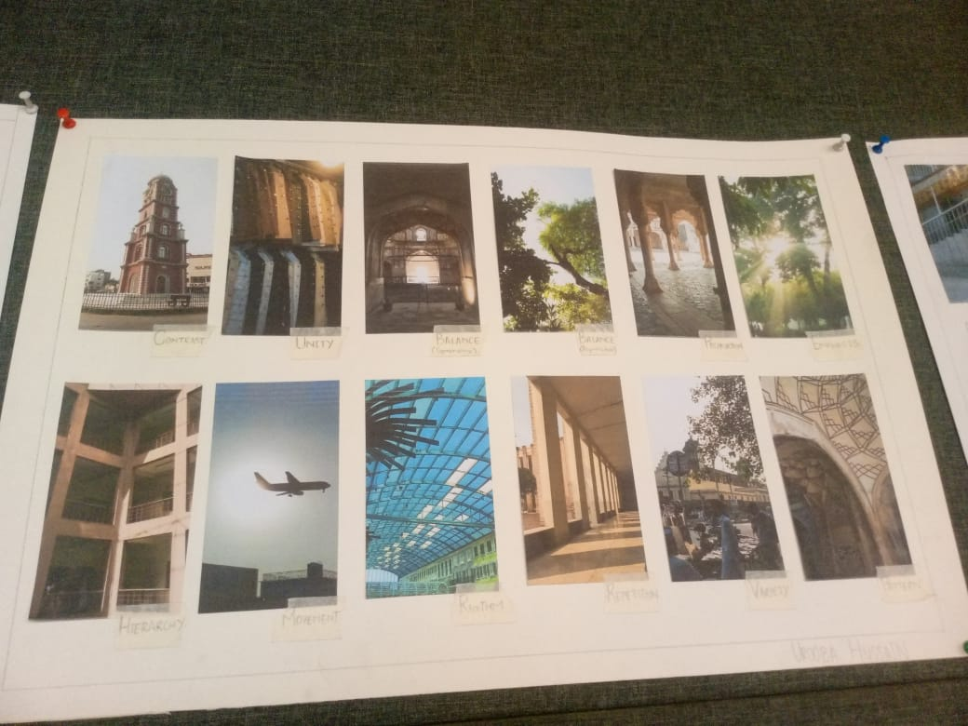
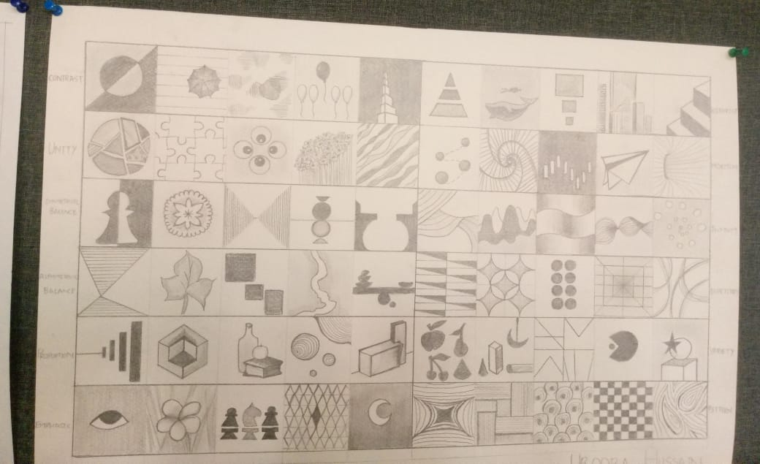
PRINCIPLES OF DESIGN
PRINCIPLES OF DESIGN
PATTERN
HEIRARCHY
MOVEMENT
IMAGES OF THESE PRINCIPLES
Let’s your dream space into reality

